Slide 1
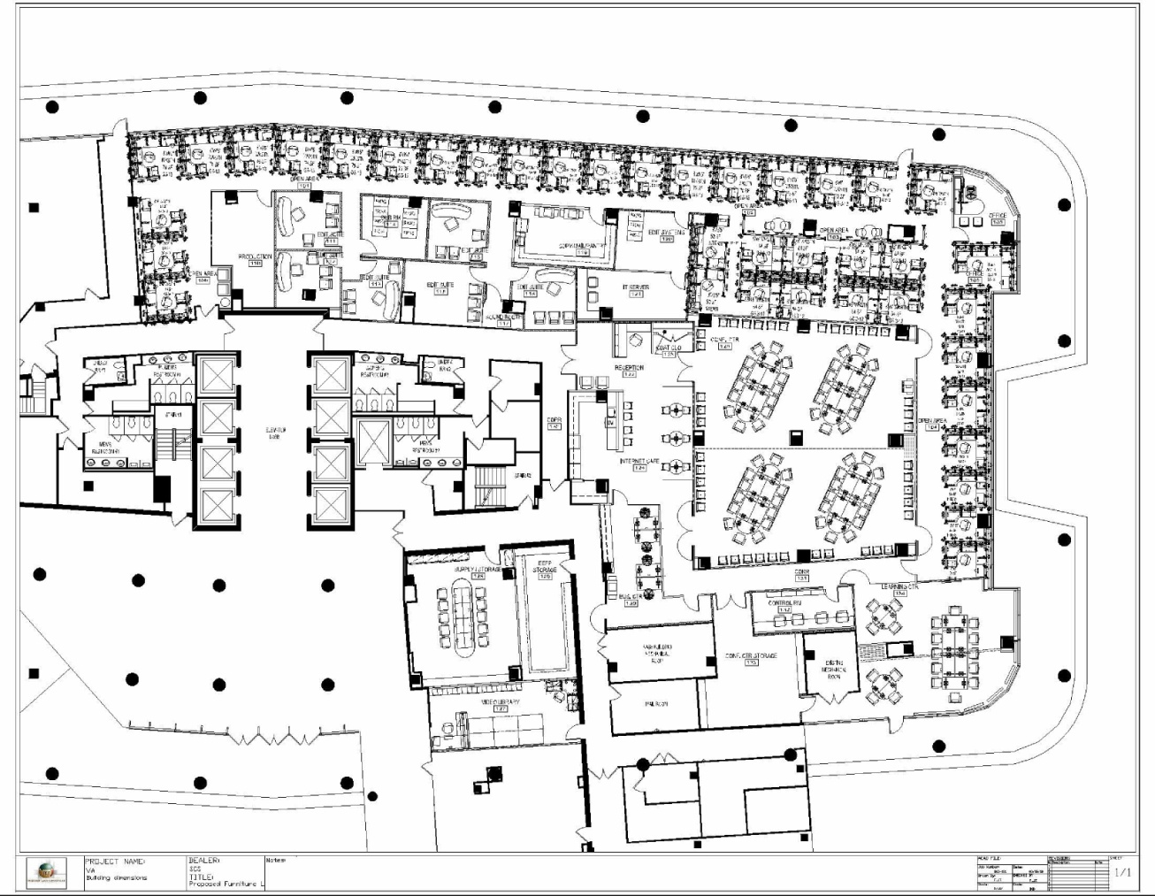
Suite 150A VHA National Conference Center
Restrooms
Crystal Drive
Cosi’s/Noodle & Company
Main Entrance

