Slide 1
LEGISLATION 101
Gold Star Wives of America, Inc.
2022

Slide 2
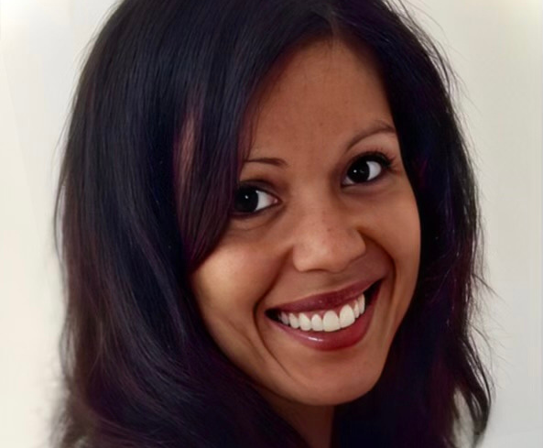
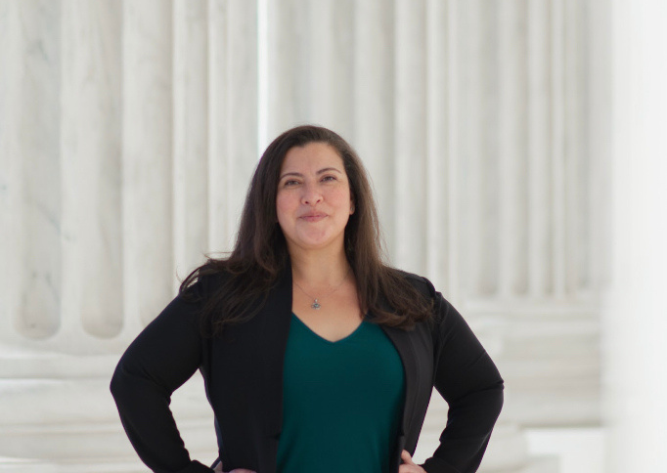
Government Relations Committee Co-Chairwomen
My name is Misty J Brammer, and I am the widow of Staff Sergeant Kerry J Brammer, US Army
medic who died active duty on August 5, 2005, while stationed in Alaska. Alaska is home but I
currently reside in Colorado. I have been serving on the GRC since 2016 and now have the
privilege of co-chairing this committee. I have been active in both State and National legislation
for many years. I hold a master’s degree in macro level Social Work with an emphasis in public
policy. I love systems level work, particularly legislation that benefits vulnerable populations. I
have served on legislative committees outside of Gold Star Spouses and have had the
opportunity to be a part of legislative change including changes to Colorado state law and
testimony on the Hill for Gold Star Spouses. I look forward to actively working our legislative
priorities!
MistyJBrammer@gmail.com
My name is Gabriella (Gabby) Kubinyi, and I am the widow of PO2 Jeffrey L. Ferren, US Navy
Engineman, who died on active duty on April 2, 2012, while stationed in Norfolk, Virginia. I have
completed American University’s Graduate Gateway Program in Applied Politics and completed
the internship portion of the program with the Veterans of Foreign Wars (VFW) National
Legislative Service on Capitol Hill. I also worked for the VFW as a Legislative Assistant for the
VFW’s National Legislative Service. Along with a portfolio of legislative issues, I also managed
the VFW’s grassroots advocacy program. I am currently working on a master’s degree in
Political Management at George Washington University. I’m looking forward to working on
passing our legislative priorities!
gkubinyi@gmail.com
2022

Slide 3
THE GOVERNMENT RELATIONS COMMITTEE (GRC)
Congress are the people's elected officials. As Americans we have the right to advocate for issues that are important to us. The GRC will be the leaders for each of the 8 regions on legislative advocacy actions. Focusing on the priorities set out at the Gold Star Wives, Inc. National Convention.
WHY?
Each region has two places on the GRC, one spot was nominated by each region president, the second spot was selected by the co-chairs.
WHO?
WHAT?
Every member should look towards their region's GRC members for assistance and information with legislative activities.
Our goal is to create and strengthen relationships with our Congresspeople. As bills are introduced in the new 118th Congress, we will push out information on what specific bills we need to advocate for.
HOW?
2022

Slide 4
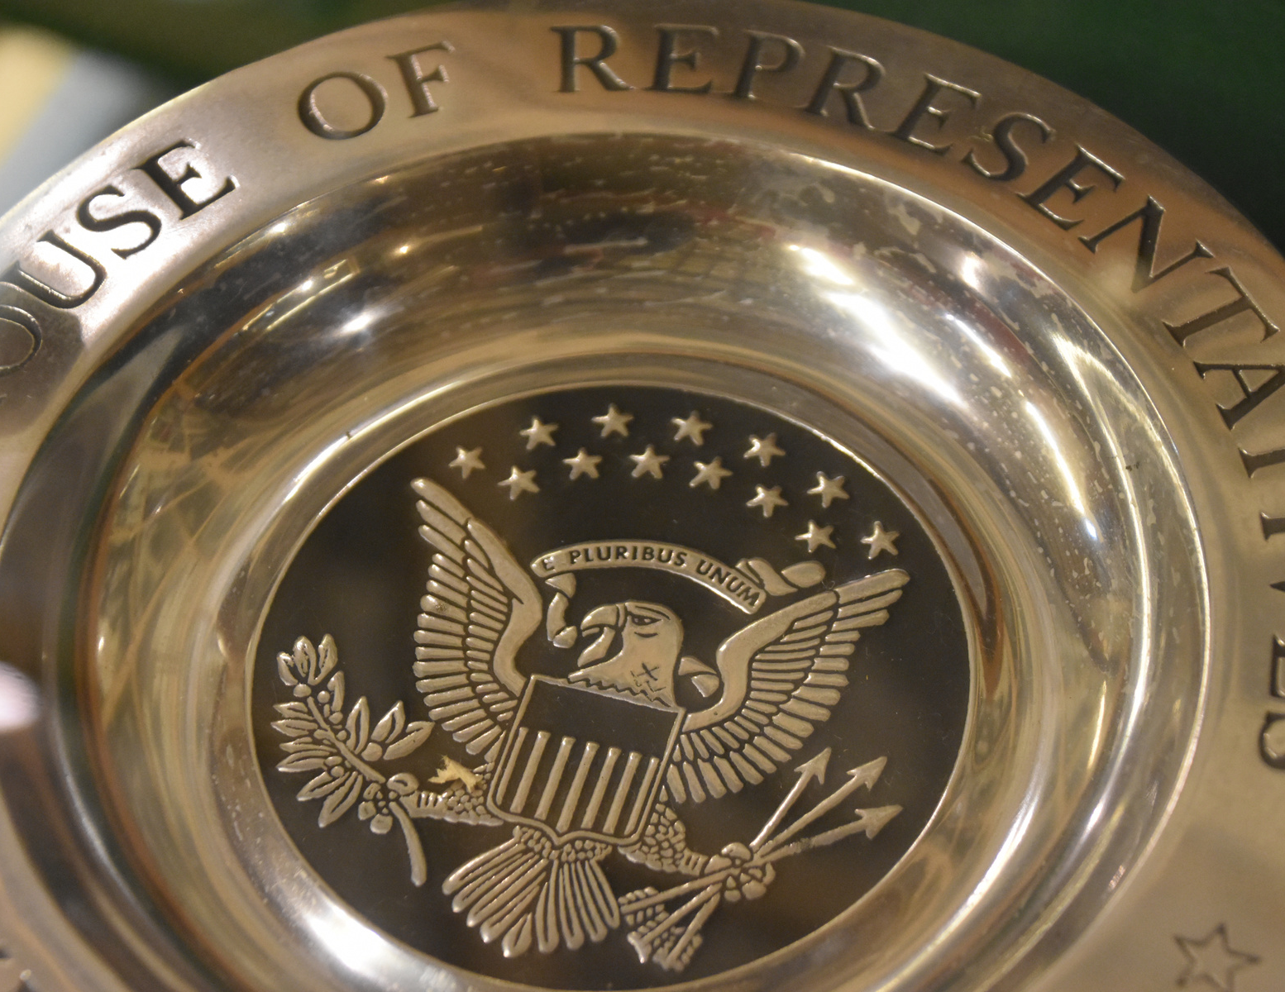
U.S. CONGRESS
January 2023 starts the 118th Congress which will last for 2 years.
The United States Congress is made of up two entities:
The House of Representatives
435 Representatives - Each state has Congresspeople based on population of each state
The Senate
100 Senators - 2 per state
This means every American citizen has:
1 Represenative - based on your home address
AND
2 Senators - based on your home state
2022

Slide 5
HOW CONGRESS WORKS
How a Bill Becomes A Law
Learn more about Congress
2022

Slide 6
COMMITTEES OF RELEVANCE
The House Committee on Veterans'Affairs
House Armed Services Committee
Oversees agencies, reviews current legislation, recommends new bills or ammentments for veterans. Areas include retiring and disability pension, life insurance, education, vocational training, medical care, home loans, and cemeteries.
Responsible for funding and oversight of the Department of Defense, the U.S. Armed Forces, and part of Department of Energy.
United States Senate Committee on Armed Services
U. S. Senate Committee on Veterans' Affairs
Legislative Oversight of the Department of Veterans Affairs.
Legislative oversight over the Department of Defense, military research and development, nuclear energy, benefits for members of the military, the Selected Service System, and other matters related to defense politcy
2022

Slide 7
CONTACTING CONGRESS
Every Congressperson and Senator have offices in their home district or state as well as an office in Washington, DC. Focus on the DC office.
Find Your Members of Congress https://www.congress.gov/members/find-your-member
Find Your U.S. House Representative
https://www.house.gov/representatives/find-your-representative
Find Your U.S. Senator
https://www.senate.gov/senators/senators-contact.htm
2022

Slide 8
Call their office
HOW TO CONTACT YOUR LEGISLATORS
Write an email/letter
Go to a townhall or other event
Introduce yourself.
Identify yourself as a constituent.
Ask them to support specific legislation.
Tell them how the proposed bill would affect your life.
Get to know their military or veteran legislative assistant. Many legislators give weight to the opinions of the legislative assistants
Thank them for their time and attention.
Keep in Touch. Respectfully.
2022

Slide 9
BILL TRACKING & INFORMATION
www.Congress.gov
What can you find?
Any bill with all it's actions, floor calendars, committee reports, roll call votes, set email alerts and updates
For any bill, you can see a summary, the actual bill text, actions, titles, amendments, cosponsors, committees, and any related bills.
2022

Slide 10
LEGISLATIVE PRIORITIES
DIC Increase
Department of Veterans Affairs (VA) provides Dependency and Indemnity Compensation (DIC) to the surviving spouse, child, or parent of a service member who died in the line of duty, or the survivor of a Veteran who died from a service-related injury or illness. This benefit is tax-free.
Remarriage
Surviving spouses of service members and veterans deserve to maintain their benefits should they remarry. Many other groups of survivors are allowed to move on with their lives without having to worry about losing their financial safety net. Military surviving spouses deserve the same respect.
2022

Slide 11
LEGISLATIVE PRIORITIES
Caring for Survivors Act of 2021
This bill would do two things:
Increase the amount of Dependency and Indemnity Compensation for surviving spouses. The base rate will change from 42% of a 100% service-connected veteran's compensation to 55%. If the surviving spouse became one before 1993, they get the higher calculated benefit.
2. Modify the requirements for DIC for survivors of certain veterans rated totally disabled at time of death. If the rating is held for less than 10 years but more than 5 years, the surviving spouse would receive a prorated amount that correlates with years at that a totally disabled rating.
This bill was introduced in the House as HR 3402
Originally sponsored by Rep. Johana Hayes, CT
Rep. Lois Frankel, FL
Rep. Raul Grijalva, AZ
Currently has 70 cosponsors
This bill was introduced in the Senate at S. 976
Originally sponsored by Sen. Jon Tester, MT
Sen. John Boozman, AR
Currently has 14 cosponsors
2022

Slide 12
LEGISLATIVE PRIORITIES
Love Lives on Act of 2022
This bill would allow surviving spouses of all ages to remarry without losing Dependency and Indemnity Compensation (DIC) or Survivor Benefit Plan (SBP) It would reestablish benefits for those who previously remarried. It would also provide commissary and exchange access to remarried surviving spouses. As well as allow surviving spouses whose subsequent marriage has ended to qualify as a dependent under Tricare. It would also preserve surviving spouse eligibility for the Fry Scholarship.
This bill was introduced in the Senate at S. 4841
Originally sponsored by Sen. Rafael Warnock, GA
Sen. Jerry Moran, KS
Currently has 1 cosponsor
This bill was introduced in the House as HR 9287
Originally sponsored by Rep. Dean Phillips, MN
Rep. Richard Hudson, NC
Rep. Gwen Moore, WI
Currently has 2 cosponsors
2022

Slide 13
FIRST ACTION
Every Congressperson and Senator should have someone on staff with a legislative portfolio that covers military and veteran affairs. Sometimes it's the same person, sometimes there are two, one covering that chamber's Veterans Affairs Committee and one covering the Armed Services Committee.
Contact your one congressman and each of your two senators and introduce yourself to their veteran legislative assistant and get all their contact information.
Let them know the community has some important priorities that could make a huge difference in the lives of surviving spouses, and you would like to talk to them about these issues as well as work with them on solutions.
2022

